Slide 1
Accelerating gradient-based topology optimization design with dual-model neural networks
Chao Qian, Wenjing Ye
Presented by Rui Xiao
SCUT Machine Intelligence Laboratory
Nov 25, 2021

Slide 2
Contents
1
Background
2
Motivation
3
Proposed Method
4
Experimental Results
5
Conclusion

Slide 3
Contents
1
Background
2
Motivation
3
Proposed Method
4
Experimental Results
5
Conclusion

Slide 4
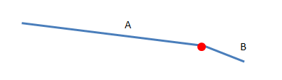
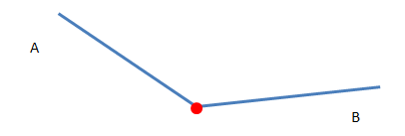
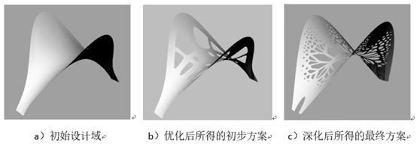
Topology optimization
Topology optimization is a mathematical technique commonly used in free-form designs.
Almost all TO methods are cursed with the exorbitant computational cost.

Slide 5
Machine Learning Techniques
Using various machine learning techniques to speed up the evaluation of the objective function.
The need of a large number of training data
High-dimensional simulations are often used to generate groundtruth values
Using various neural networks to directly produce design solutions
The generation of training data requires only forward calculations
Shape constraints can be easily imposed in the topology optimization design
The optimal design obtained by this approach is confined within the design space generated by the GAN.

Slide 6
Contents
1
Background
2
Motivation
3
Proposed Method
4
Experimental Results
5
Conclusion

Slide 7
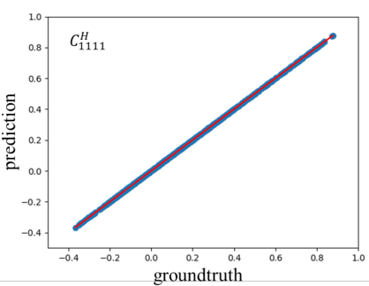
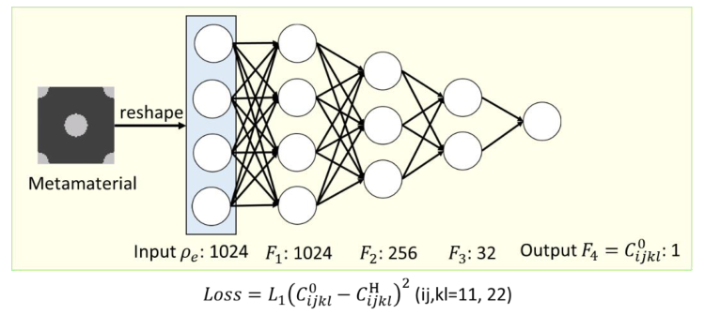
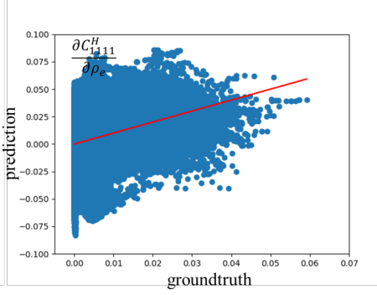
Motivation
Motivation Of Dual-model Neural Networks
The accuracy of these sensitivities obtained by back-propagating the neural network is limited by the accuracy of the neural network in its forward prediction.

Slide 8
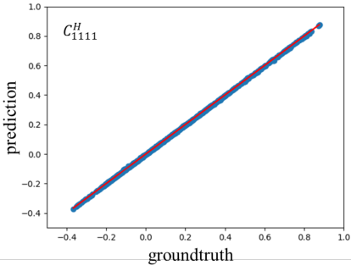
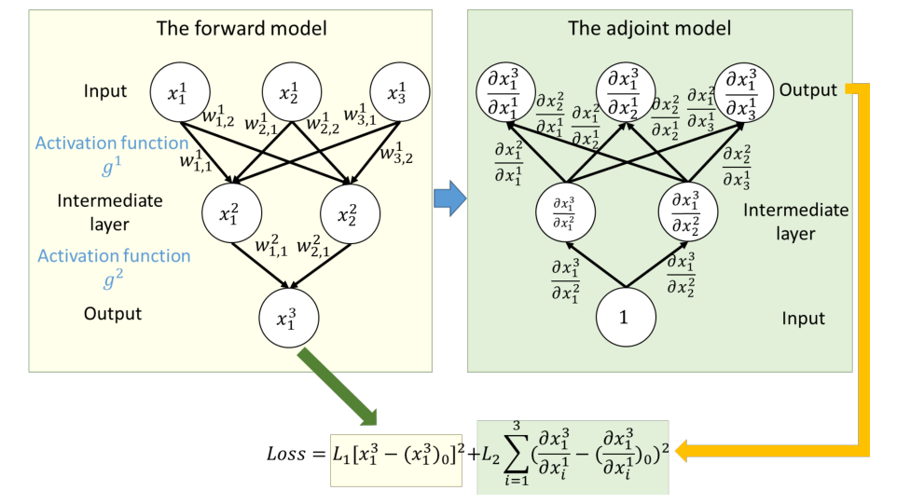
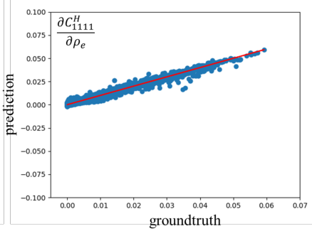
Motivation
Motivation Of Dual-model Neural Networks
To improve the prediction accuracy of sensitivity, a dual-model neural network is employed in this work.

Slide 9
Contents
1
Background
2
Motivation
3
Proposed Method
4
Experimental Results
5
Conclusion

Slide 10
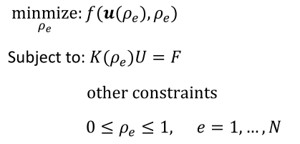
SMIP
In the SIMP method, the design domain is discretized into many small elements.
Each element is assigned a continuous density value between 0 and 1, where 0 and 1 represent two different phases respectively.
For single-phase structure design, the local Young’s modulus of each element is defined as follows:
A general topology optimization formulation for density based structure design is listed as follows:

Slide 11
Minimal Compliance Design
The design objective is to design a structure that is as stiff as possible with a given amount of material and subjected to given loading and boundary conditions.
In this work, a serial of cantilever structures with different loading conditions and volume fractions are to be designed.
The range of the volume fraction is set to be [0.3, 0.7]. The applied load is a vertical distributed load with a fixed magnitude. But the location of the force varies along the right edge of the design domain. The left boundary is fixed and all other sides are free.

Slide 12
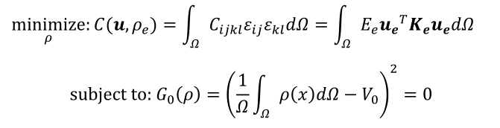

Minimal Compliance Design

Slide 13
Minimal Compliance Design

Slide 14
Minimal Compliance Design

Slide 15
Minimal Compliance Design

Slide 16
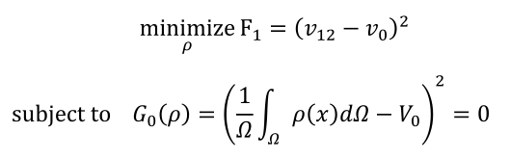

Metamaterials With Negative Poisson’s Ratio
Metamaterials are artificial materials with unique properties. Through the design of the microstructure of their building blocks, novel properties can be achieved.
A set of 2D metamaterials with desired Poisson’s ratios in the range of [0.6, 0] and given volume fractions in the range of [0.3, 0.65] will be designed. This design problem can be formulated as an TO problem described in Eqn:

Slide 17

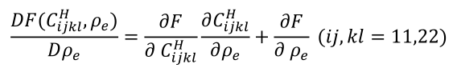
Metamaterials With Negative Poisson’s Ratio
Metamaterials are artificial materials with unique properties. Through the design of the microstructure of their building blocks, novel properties can be achieved.
A set of 2D metamaterials with desired Poisson’s ratios in the range of [0.6, 0] and given volume fractions in the range of [0.3, 0.65] will be designed. This design problem can be formulated as an TO problem described in Eqn:

Slide 18
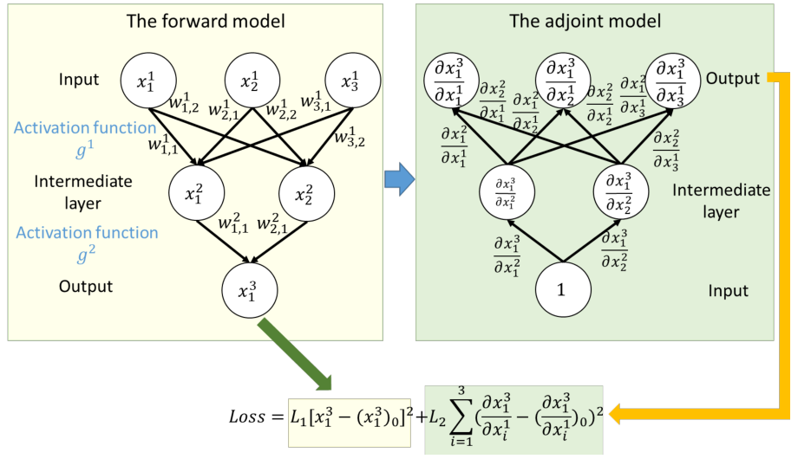
Dual-model Neural Networks
The dual-model neural network, which is trained to produce accurate results for both forward prediction and sensitivity calculation, is employed in this work. This is done by adding the loss corresponding sensitivity into the original loss function.
The adjoint network is essentially the inverse net of the forward model but with a linear activity function and different weights.

Slide 19


Dual-model Neural Networks
The value of each neuron in the forward model can be computed as :
These neuron values can be calculated sequentially from the input neuron to output neurons following the chain rule：

Slide 20
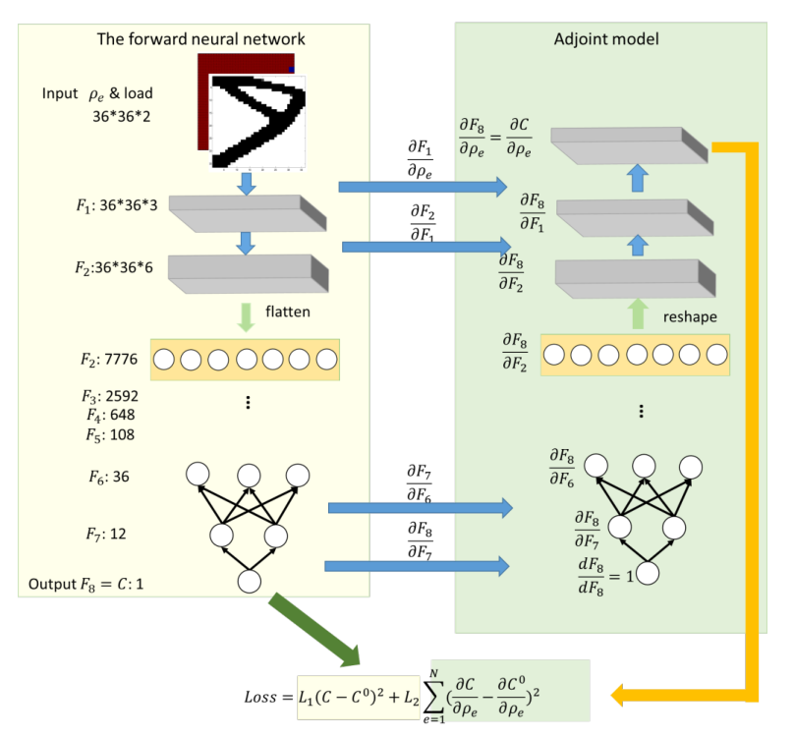
Proposed Method
Dual-model convolutional neural network for the minimal compliance design
To design a cantilever structure, a dual-model NN is constructed to compute the compliance of the structure using a forward model and its derivatives with respect to the density of each element using an adjoint model.

Slide 21
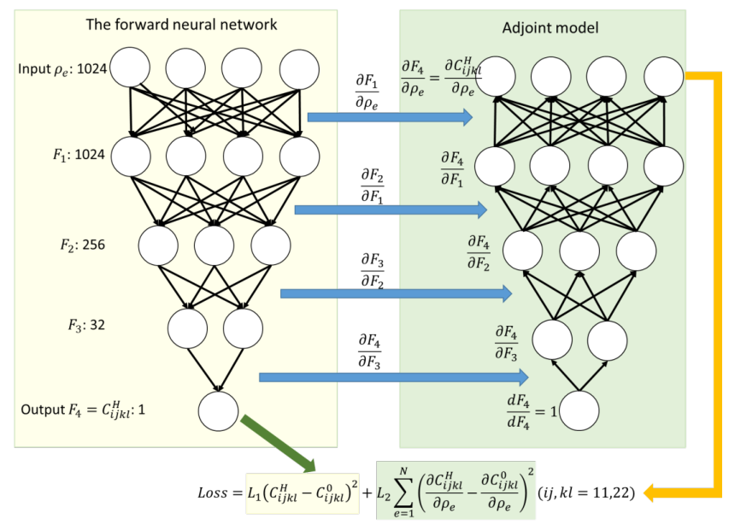
Proposed Method
Dual-model neural network for the design of metamaterials with negative
Poisson’s ratios
For the design of metamaterials with negative Poisson’s ratios, a dual-model fully connected network is constructed to predict the effective stiffness component of the material and its sensitivities with respect to the density of each element.

Slide 22
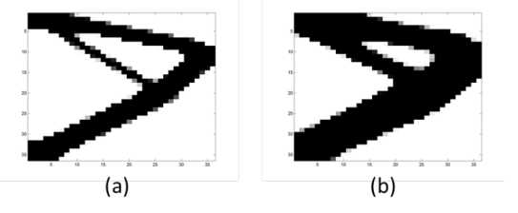
Data Generation
Unlike those typical application areas of machine learning in which abundant data are available, the training data required in the supervising learning of physical problems has to be obtained either from high-dimensional simulations or experimental measurements.
In this work, instead of generating random structures to form the dataset, the conventional topology optimization method is used to conduct the design for a few selected design cases.
Two design solutions with minimal compliance subjected to the same loading condition but with different volume fractions
In most TO designs, the topology of the structure only evolves rapidly during the early design stage and maintains almost the same during the later stage of the design.

Slide 23
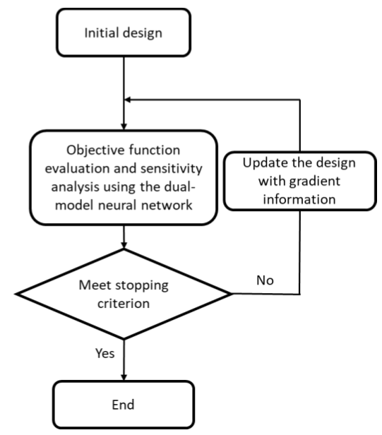
NN-accelerated Topology Optimization Algorithm
Once the dual-model neural network is constructed and trained, it can be integrated into the topology optimization algorithm to speed up the design process.
A genetic flow chart of the NN-accelerated topology algorithm.

Slide 24
Contents
1
Background
2
Motivation
3
Proposed Method
4
Experimental Results
5
Conclusion

Slide 25
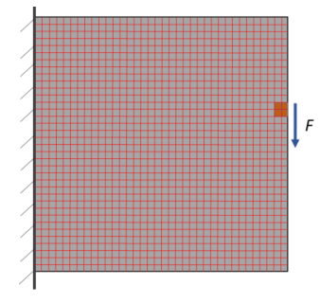
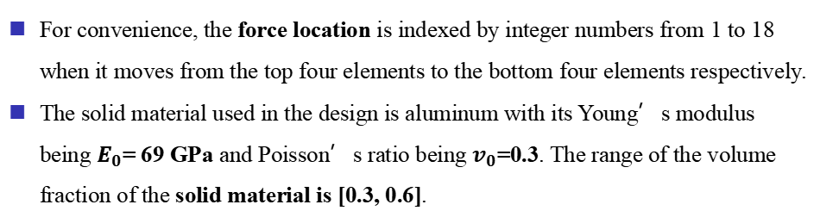
Minimal Compliance Design
For convenience, the force location is indexed by integer numbers from 1 to 18 when it moves from the top four elements to the bottom four elements respectively.
The solid material used in the design is aluminum with its Young’s modulus being $E_{0}$= 69 GPa and Poisson’s ratio being $v_{0}$=0.3. The range of the volume fraction of the solid material is [0.3, 0.6].

Slide 26
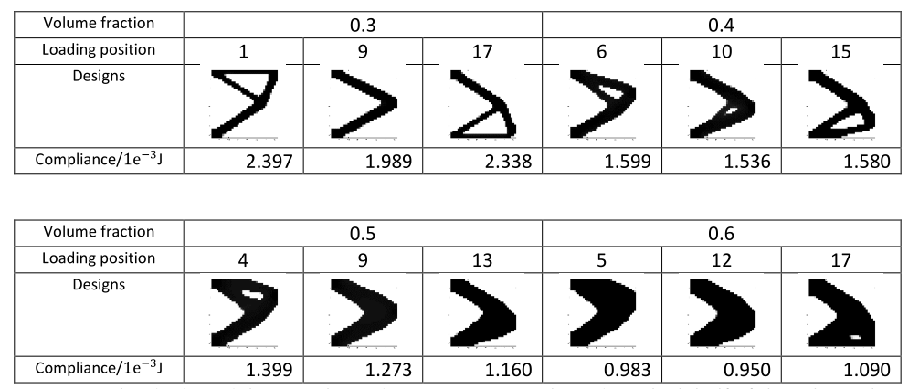
Minimal Compliance Design
Optimal cantilever designs corresponding to different loading conditions and volume fractions obtained from the SIMP method combined with the FEM.
To train the dual-model network, 18 design cases are selected in which half of them have the same target volume fraction of 0.35 and odd force indexes ranging from 1 to 17.

Slide 27
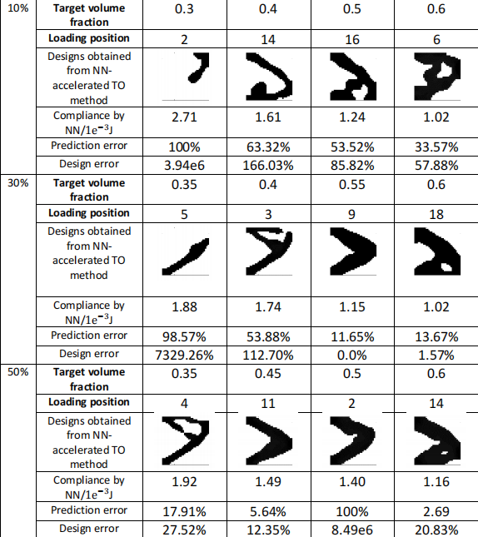
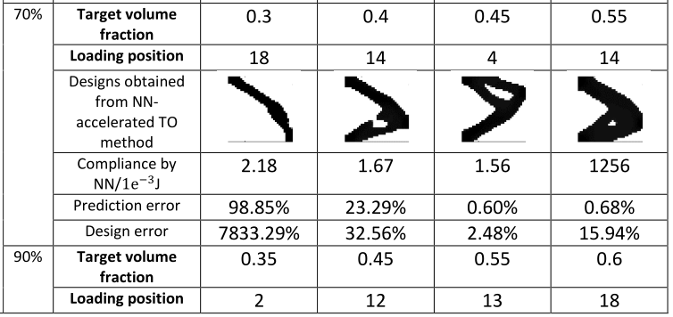
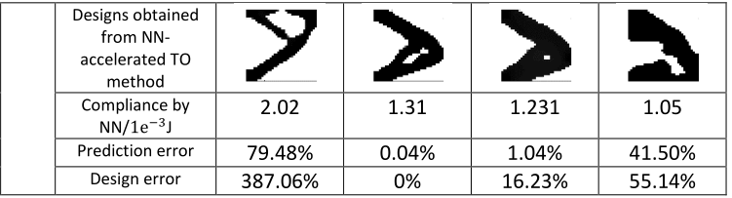
Minimal Compliance Design
Five original training datasets are then formed containing structures generated at five different design stages, that is, the early 10%, 30%, 50%, 70% and 90% of the total number of iterations.

Slide 28


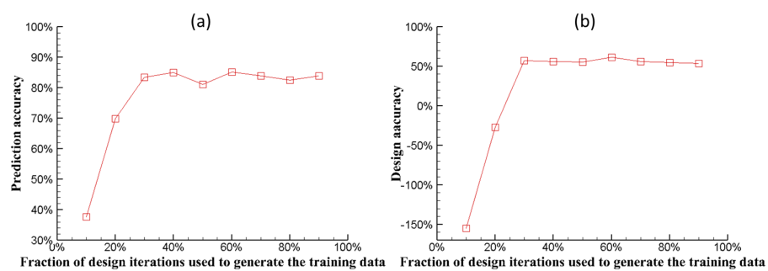
Minimal Compliance Design

Slide 29
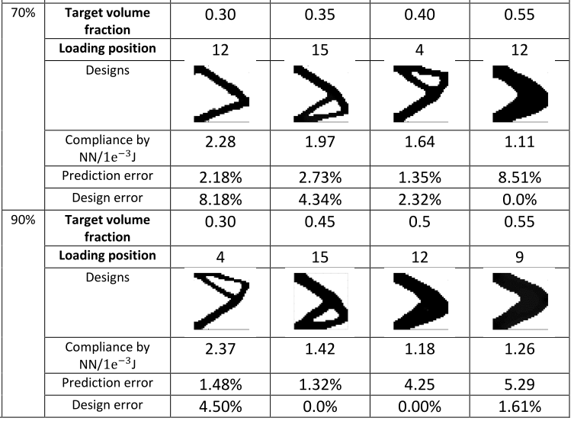
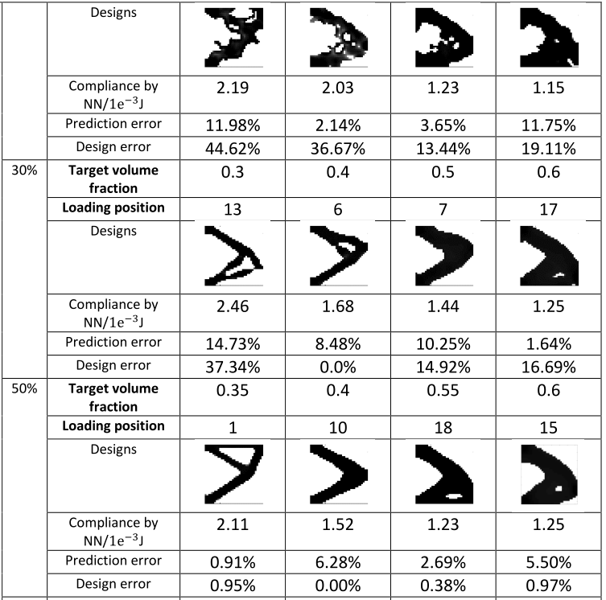
Minimal Compliance Design
To improve the prediction accuracy, more variety of data has to be added to the training set. Density filtering and density projection are first performed to generate more structures.

Slide 30
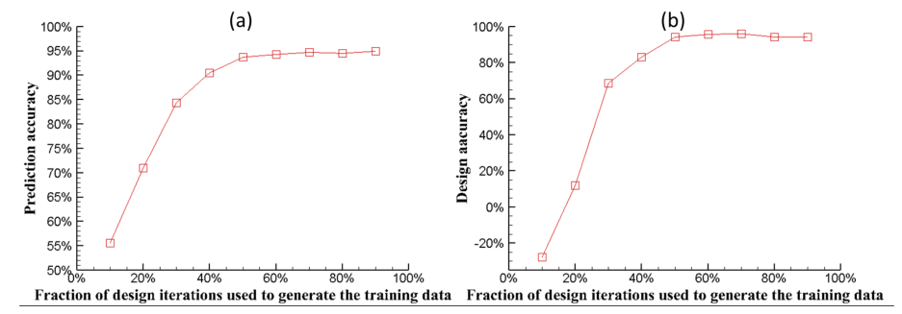
Minimal Compliance Design

Slide 31
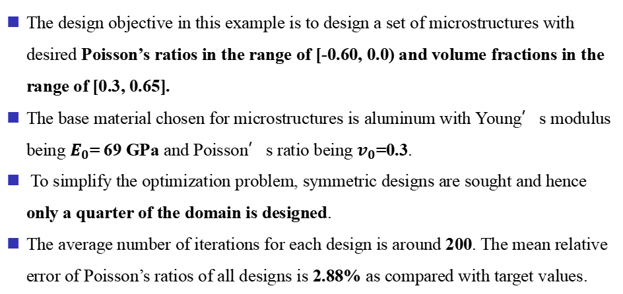
Metamaterials With Negative Poisson’s Ratios
The design objective in this example is to design a set of microstructures with desired Poisson’s ratios in the range of [-0.60, 0.0) and volume fractions in the range of [0.3, 0.65].
The base material chosen for microstructures is aluminum with Young’s modulus being $E_{0}$= 69 GPa and Poisson’s ratio being $v_{0}$=0.3.
To simplify the optimization problem, symmetric designs are sought and hence only a quarter of the domain is designed.
The average number of iterations for each design is around 200. The mean relative error of Poisson’s ratios of all designs is 2.88% as compared with target values.

Slide 32
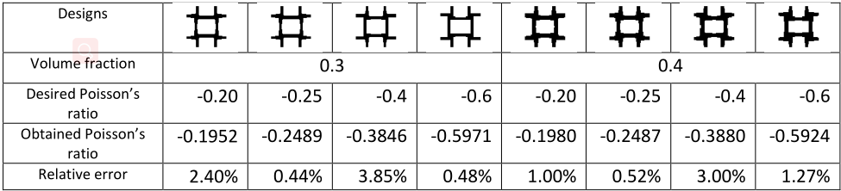
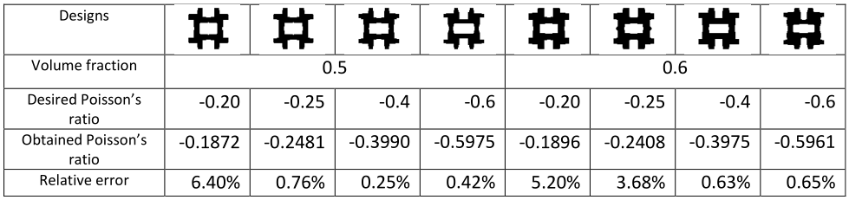
Metamaterials With Negative Poisson’s Ratios
The design objective in this example is to design a set of microstructures with desired Poisson’s ratios in the range of [-0.60, 0.0) and volume fractions in the range of [0.3, 0.65].

Slide 33
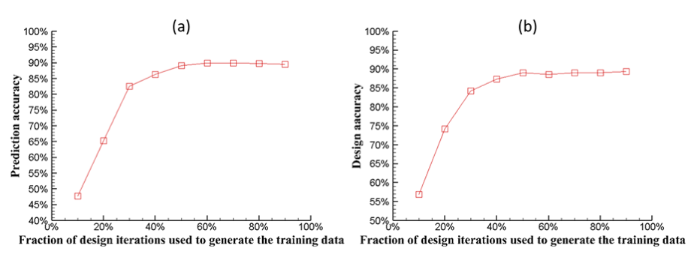
Metamaterials With Negative Poisson’s Ratios
The average prediction accuracy (a) and the average design accuracy (b) of the dual-model NN versus the fraction of iterations used to generate the original training data in the design of metamaterials with negative Poisson’s ratios.

Slide 34
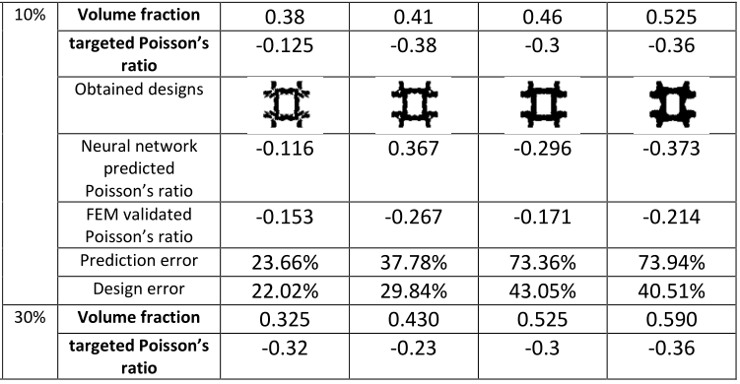
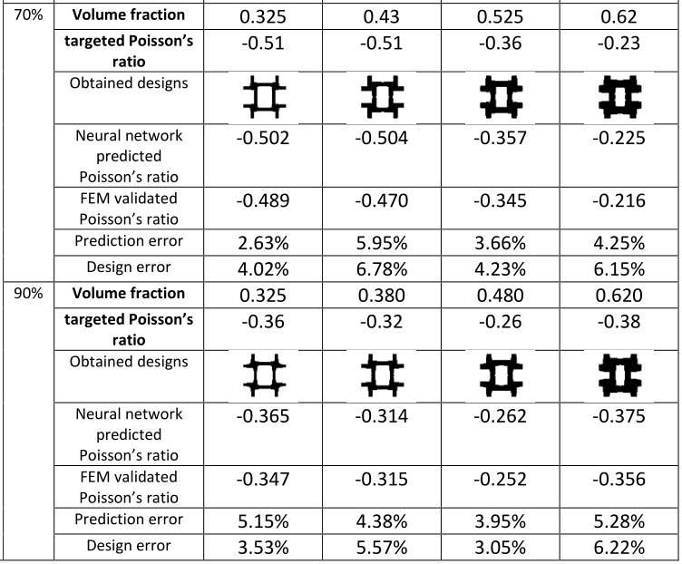
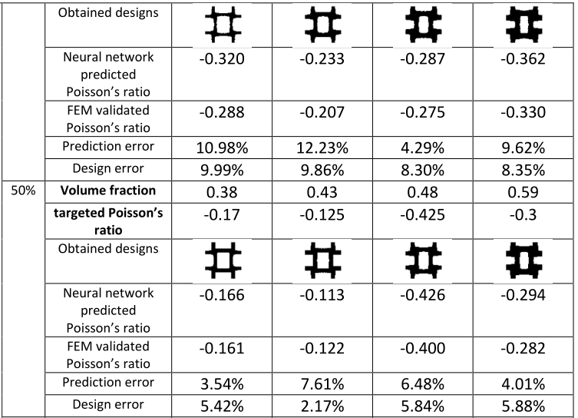
Metamaterials With Negative Poisson’s Ratios
To improve the prediction accuracy, more variety of data has to be added to the training set. Density filtering and density projection are first performed to generate more structures.

Slide 35
Metamaterials With Negative Poisson’s Ratios
To improve the prediction accuracy, more variety of data has to be added to the training set. Density filtering and density projection are first performed to generate more structures.

Slide 36
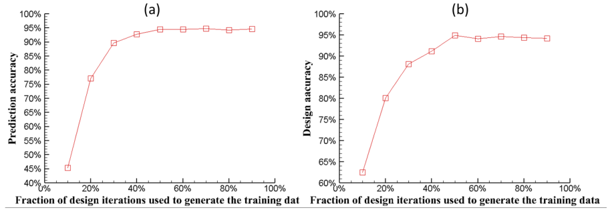
Metamaterials With Negative Poisson’s Ratios
The average prediction accuracy (a) and the average design accuracy (b) of the dual-model NN trained with augmented datasets versus the fraction of iterations used to generate the original training data in the design of metamaterials with negative Poisson’s ratios

Slide 37
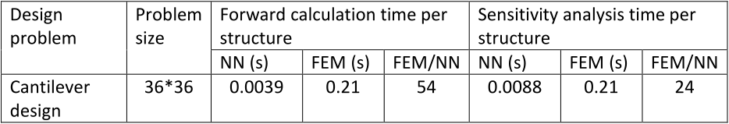
Experimental Results
For dual-model neural networks, sensitivity analysis is performed simultaneously with the forward calculation and needs twice amount of the time of the forward calculation.

Slide 38
Contents
1
Background
2
Motivation
3
Proposed Method
4
Experimental Results
5
Conclusion

Slide 39
Conclusion
Contributions
In this work, dual-model neural networks are proposed and used to accelerate gradientbased TO methods for structure/material designs.
To reduce the amount of training data, effective data generation methods suitable for TO designs are studied and proposed.
Future work
The proposed method, that is, using dual-model neural networks as the surrogate models, should be applicable to three dimensional and/or nonlinear problems.

Slide 40
Thank You
Thank You
Q&A

